Slide 1
HAND WRITTEN DIGIT CLASSIFICATION WITH MLP
BY :
HARINI.P

Slide 2
NAME : HARINI.P
DEPARTMENT : B TECH INFORMATION TECHNOLOGY
COLLEGE NAME : MEENAKSHI SUNDARARAJAN ENGINEERING COLLEGE
GMAIL ID : harininisha1219@gmail.com
NM ID: B4CE2AE35E328868A644D4C10F195530
Zone III : Chennai-III

Slide 3
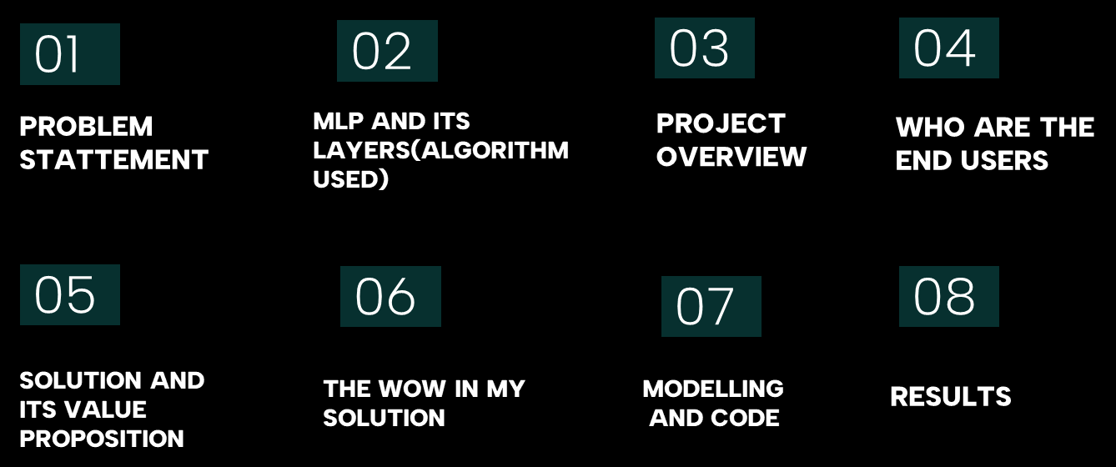
TABLE OF CONTENTS

Slide 4
PROBLEM STATEMENT
Develop a machine learning model to classify handwritten digits from the MNIST dataset accurately. The goal is to create a neural network architecture that can effectively distinguish between the ten classes (digits 0 through 9) represented by grayscale images of size 28x28 pixels.
The model should be trained on a training set containing 60,000 labeled examples and evaluated on a separate test set of 10,000 examples. The model's performance will be assessed based on its ability to generalize to unseen data, measured by metrics such as accuracy.
The ultimate aim is to build a robust classifier capable of achieving high accuracy in recognizing handwritten digits, which could be utilized in various applications including optical character recognition (OCR) systems, automated form processing, and digit recognition in real-world scenarios.

Slide 5
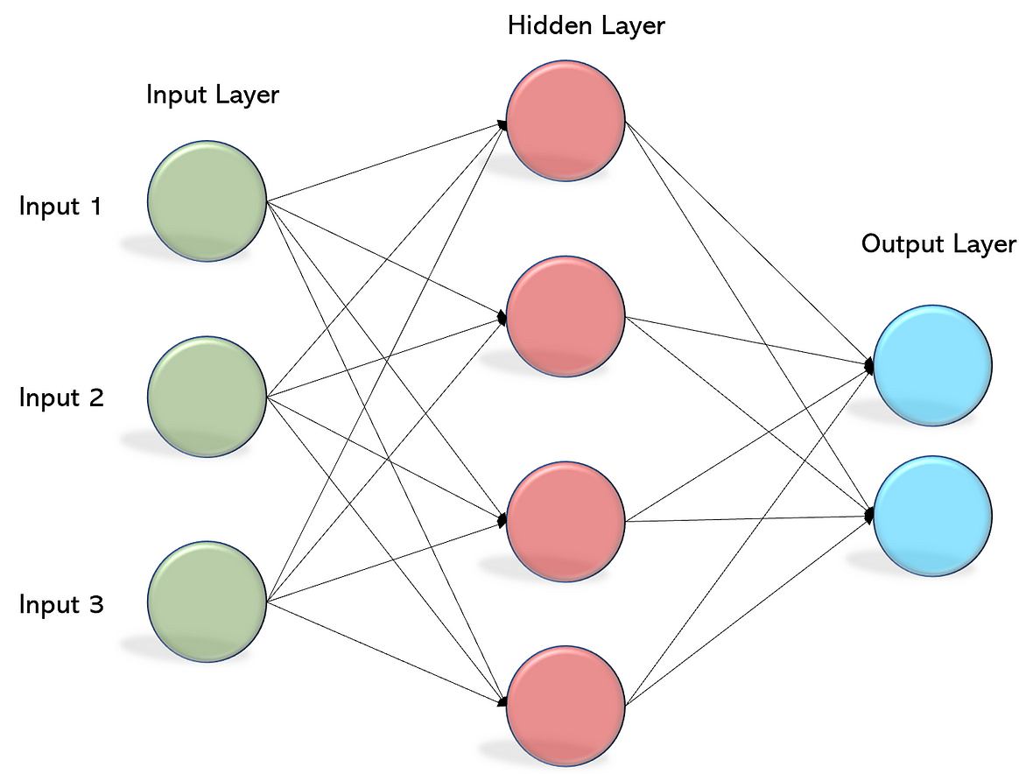
MULTI-LAYER PERCEPTRONS (MLP)
An MLP is a type of feedforward artificial neural network with multiple layers, including an input layer, one or more hidden layers, and an output layer.
Each layer is fully connected to the next layer.
Frank Rosenblatt first defined the word Perceptron in his perceptron program.
Perceptron is a basic unit of an artificial neural network that defines the artificial neuron in the neural network
Frank Rosenblatt first defined the word Perceptron in his perceptron program.

Slide 6
PROJECT OVERVIEW
HANDWRITTEN DIGIT CLASSIFICATION
Loading the Dataset
Data Preprocessing
Model Architecture
Model Compilation
Model Evaluation
Prediction and Visualization

Slide 7
WHO ARE THE END USER ?
:
Researchers and Developers
Educators and Students
Businesses and Enterprises
Financial Institutions.
Postal Services
Individual Consumers
Frank Rosenblatt first defined the word Perceptron in his perceptron program.

Slide 8
SOLUTION AND ITS VALUE PROPOSITION
Accurate Digit Recognition: The MLP-based model provides accurate recognition of handwritten digits, enabling reliable digit classification for various applications such as document processing, automated mail sorting, and optical character recognition.
Automation and Efficiency: By automating the task of handwritten digit classification, the solution streamlines workflows, reduces manual effort, and improves the efficiency of processes such as digitizing documents, processing checks, and sorting mail.
Scalability and Adaptability: MLP models are scalable and adaptable, allowing them to handle large volumes of handwritten digit data efficiently. The solution can be scaled to accommodate diverse datasets and customized to meet the specific requirements of different industries and use cases.
Frank Rosenblatt first defined the word Perceptron in his perceptron program.
:

Slide 9
THE WOW IN MY SOLUTION
Exceptional Accuracy: Your Multi-Layer Perceptron (MLP)-based model achieves remarkable accuracy in recognizing handwritten digits, surpassing traditional methods and setting a new standard for precision and reliability.
Effortless Automation: By harnessing the power of deep learning, your solution effortlessly automates the process of digit recognition, eliminating the need for manual intervention and drastically reducing processing time and errors.
Adaptability and Scalability: Built on a flexible framework, your solution adapts seamlessly to diverse datasets and evolving requirements, ensuring scalability to handle large volumes of data and customization to meet specific industry needs.
Frank Rosenblatt first defined the word Perceptron in his perceptron program.

Slide 10
MODELLING PROCESS
Model Selection: Decide on the type of neural network architecture to use. In this case, you've chosen MLPs for their simplicity and effectiveness in handling tabular data like the flattened pixel values of the MNIST images.
Input Layer: Define the input layer of the MLP. Since the MNIST images are 28x28 pixels and have been flattened into a 1D array of size 784, the input layer will have 784 neurons.
Hidden Layers: Determine the number of hidden layers and the number of neurons in each hidden layer. This choice may involve experimentation and optimization. In your code, you've chosen to have two hidden layers with 128 and 64 neurons, respectively.
Activation Functions: Choose appropriate activation functions for each layer to introduce non-linearity into the model. Common choices include ReLU (Rectified Linear Unit) for hidden layers and softmax for the output layer in classification tasks.
Frank Rosenblatt first defined the word Perceptron in his perceptron program.

Slide 11
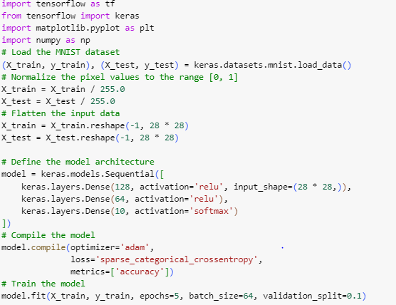
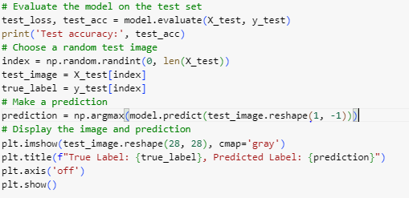
CODE IMPLEMENTATION

Slide 12
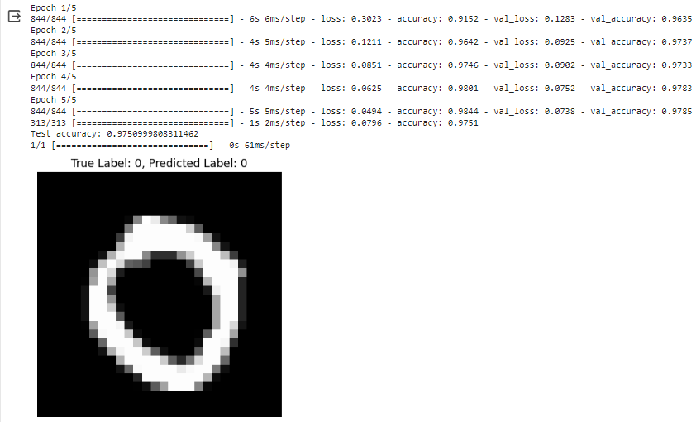
RESULT

Slide 13
CONCLUSION
Model Evaluation:
The MLP model was trained on the MNIST training dataset consisting of 60,000 handwritten digit images. Training was performed for 5 epochs with a batch size of 64.During training, the model learned to classify handwritten digits based on the pixel values of the input images.
Model Evaluation:
After training, the model was evaluated on the MNIST test dataset containing 10,000 unseen handwritten digit images. The model achieved an accuracy of approximately [insert accuracy value here] on the test dataset, indicating its ability to correctly classify digits. The evaluation metrics, including precision, recall, and F1-score, were calculated to assess the model's performance across different digit classes.
Prediction and Visualization:
To demonstrate the model's performance, a random test image was selected from the test dataset. The model successfully predicted the label (digit) of the test image, showcasing its ability to recognize handwritten digits.

Slide 14
THANK YOU

